Slide 1

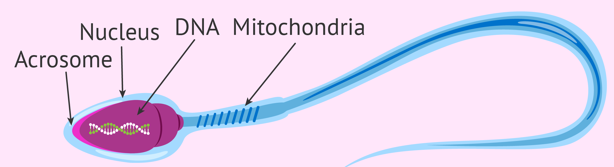
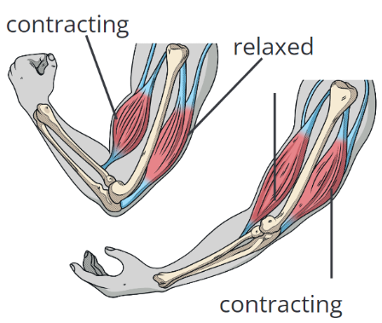
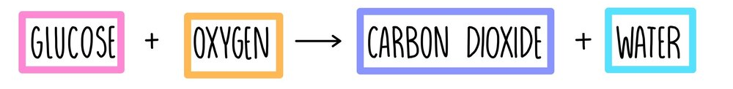
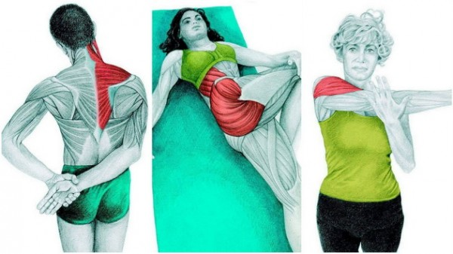
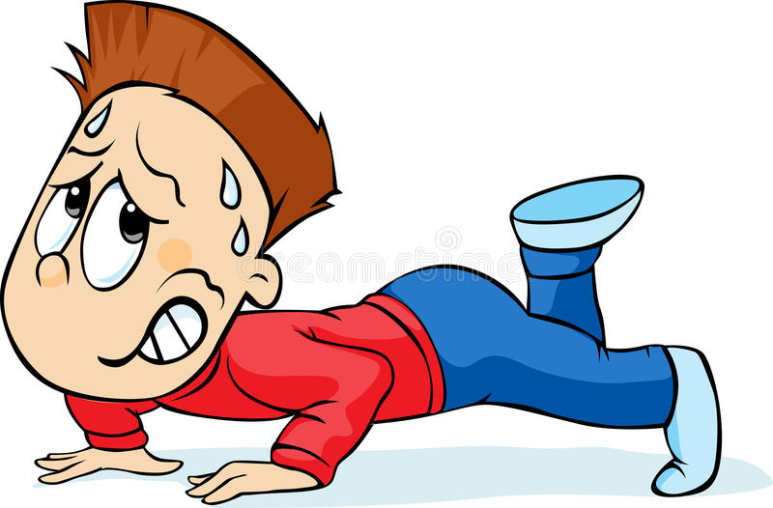


Knowledge Organiser
Year 7: Cells – Exercise and Respiration
Comparing aerobic and anaerobic respiration:
 | Aerobic | Anaerobic
Releases energy from glucouse
Can happen in all cells
Produces only carbon dioxide and water
Produces lactic acid
Happens in plentiful oxygen
Happens without oxygen
Antagonistic pairs of muscles?
A pair of muscles that work together to move are called antagonistic pairs
When one of the muscles contracts the other relaxes
This pair of movements pulls your bones in one direction or the other
What is respiration?
Respiration is a chemical reaction which occurs in all living cells
It releases energy from glucouse
Respiration happens in the mitochondria
Why is it important?
Respiration is not breathing, it is a chemical reaction which releases energy
Without it cells would not have the energy they need to do their jobs
Adaptations for respiration?
Some cells are adapted for plentiful respiration
Sperm cells are very active during their short lives, they must swim quickly to meet the egg cell and need lots of energy
See how the sperm cell has lots of densely packed mitochondria
This is the organelle responsible for respiration
The sperm cell needs lots of mitochondria so it can release plenty of energy from respiration for swimming
This diagram shows how the bicep and tricep work together to make your arm move
Chemical equation for aerobic respiration:
How does aerobic respiration work?
Mitochondria react together glucose and oxygen to form carbon dioxide and water
Energy is released during this reaction which cells can use
Aerobic respiration only works if there is plenty of oxygen
What is anaerobic respiration?
Anaerobic respiration happens when there is not enough oxygen getting to the cell
A harmful by-product called lactic acid is formed
Anaerobic respiration is less efficient than aerobic respiration – it releases less energy
It happens when we exercise vigorously
RAG Yourself!
Learning Outcomes; | RAG
Describe why respiration is important
Give the word equation for aerobic respiration
Compare aerobic and anaerobic respiration
Describe how a sperm cell is adapted for respiration
Explain how antagonistic pairs of muscles work
Explain why heart rate increases during exercise
How do muscles work?
Muscles are bundles of fibres which can stretch and store energy
They transfer the chemical energy from glucouse into kinetic (movement)
Muscles can only contract or relax, this means they can pull and not push

Slide 2
Knowledge Organiser
Year 7: Cells – Exercise and Respiration
Comparing aerobic and anaerobic respiration:
 | Aerobic | Anaerobic
Releases energy from glucouse
Can happen in all cells
Produces only carbon dioxide and water
Produces lactic acid
Happens in plentiful oxygen
Happens without oxygen
Antagonistic pairs of muscles?
What is respiration?
Why is it important?
Adaptations for respiration?
This diagram shows how the bicep and tricep work together to make your arm move
Chemical equation for aerobic respiration:
How does aerobic respiration work?
What is anaerobic respiration?
RAG Yourself!
Learning Outcomes; | RAG
Describe why respiration is important
Give the word equation for aerobic respiration
Compare aerobic and anaerobic respiration
Describe how a sperm cell is adapted for respiration
Explain how antagonistic pairs of muscles work
Explain why heart rate increases during exercise
How do muscles work?

